Slide 1
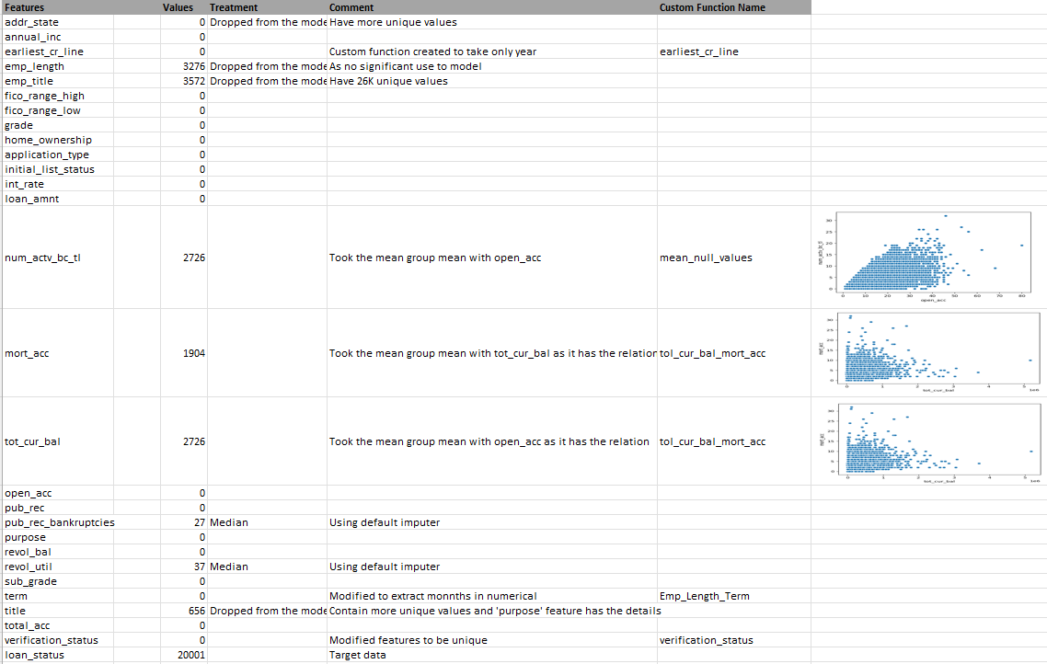
Credit Risk Assessment in Fintech Industry
(Machine Learning)
Features Treatment(Data Cleansing)

Slide 2

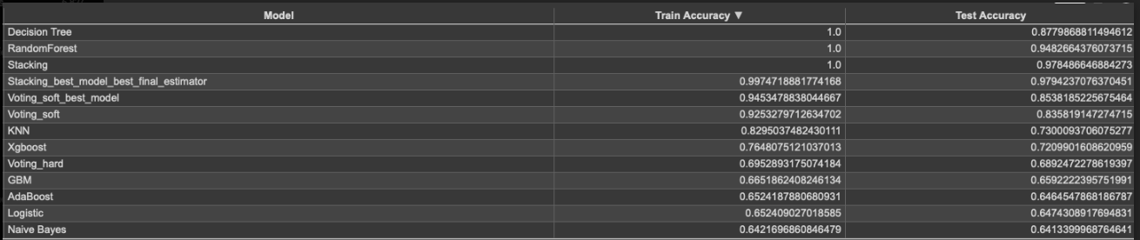
Prediction
Imbalanced data -> Random over sampler
Xgboost Model is performing better with 76% accuracy.

